Slide 1



C# Advanced Topics
Methods, Arrays, Lists, Dictionaries, Strings, Classes and Objects
SoftUni Team
Technical Trainers
Software University
http://softuni.bg

Slide 2

Table of Contents
A very brief introduction to:
Methods
Using Built-in .NET Classes
Arrays
Lists
Dictionaries
Strings
Defining Simple Classes

Slide 3
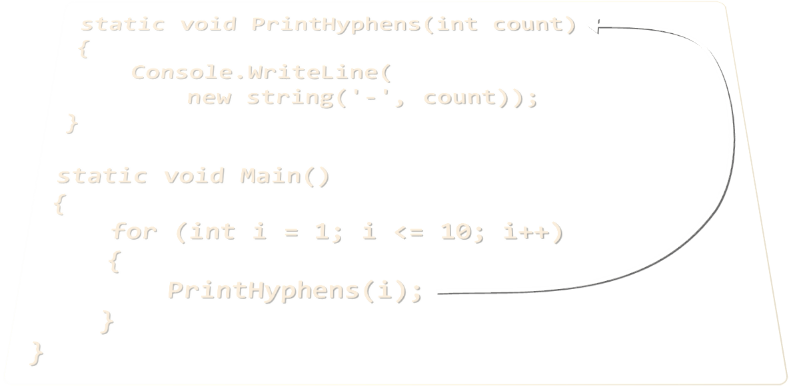
Methods
Defining and Invoking Methods

Slide 4
Methods: Defining and Invoking
Methods are named pieces of code
Defined in the class body
Can be invoked multiple times
Can take parameters
Can return a value
static void PrintHyphens(int count)
{
Console.WriteLine(
new string('-', count));
}
static void Main()
{
for (int i = 1; i <= 10; i++)
{
PrintHyphens(i);
}
}

Slide 5
Methods with Parameters and Return Value
static double CalcTriangleArea(double width, double height)
{
return width * height / 2;
}
static void Main()
{
Console.Write("Enter triangle width: ");
double width = double.Parse(Console.ReadLine());
Console.Write("Enter triangle height: ");
double height = double.Parse(Console.ReadLine());
Console.WriteLine(CalcTriangleArea(width, height));
}

Slide 6
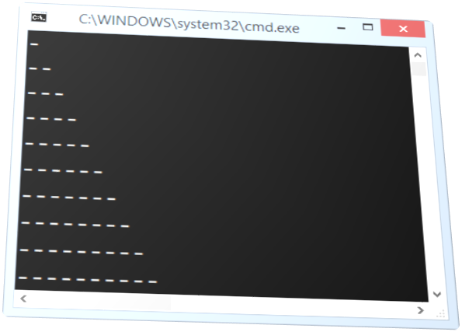
Methods
Live Demo

Slide 7
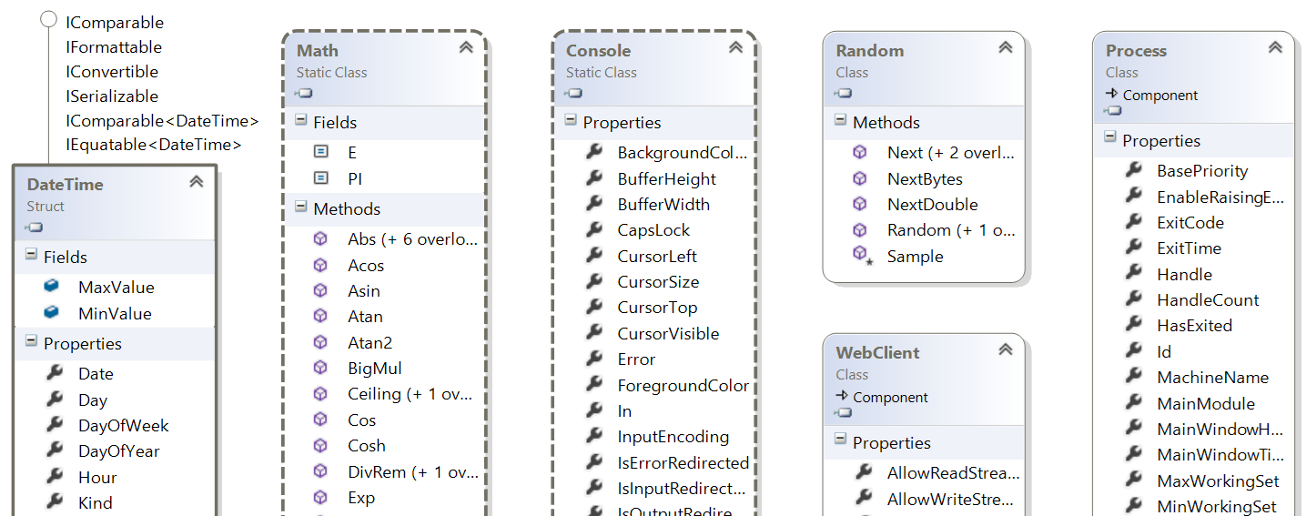
Using Built-in .NET Classes
Math, Random, Console, etc.

Slide 8
Built-in Classes in .NET Framework
.NET Framework provides thousands of ready-to-use classes
Packaged into namespaces like System, System.Net, System.Collections, System.Linq, etc.
Using static .NET classes:
Using non-static .NET classes
DateTime today = DateTime.Now;
double cosine = Math.Cos(Math.PI);
Random rnd = new Random();
int randomNumber = rnd.Next(1, 99);

Slide 9
Built-in .NET Classes – Examples
DateTime today = DateTime.Now;
Console.WriteLine("Today is: " + today);
DateTime tomorrow = today.AddDays(1);
Console.WriteLine("Tomorrow is: " + tomorrow);
double angleDegrees = 60;
double angleRadians = angleDegrees * Math.PI / 180;
Console.WriteLine(Math.Cos(angleRadians));
Random rnd = new Random();
Console.WriteLine(rnd.Next(1,100));
WebClient webClient = new WebClient();
webClient.DownloadFile("http://…", "file.pdf");
Process.Start("file.pdf");

Slide 10
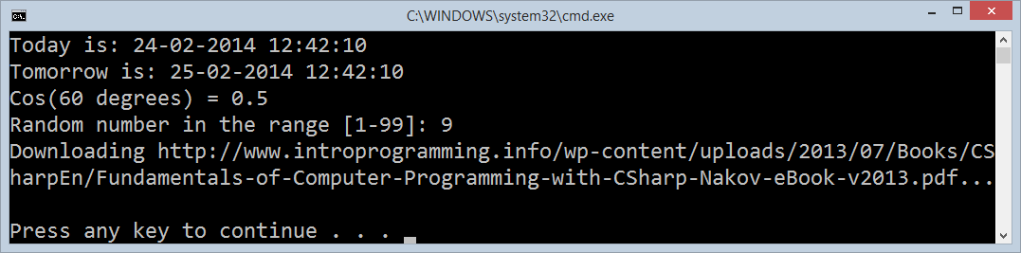
Using Built-in .NET Classes
Live Demo

Slide 11
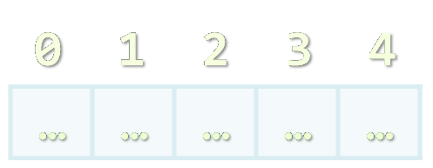
Arrays
Working with Arrays of Elements

Slide 12
What are Arrays?
In programming array is a sequence of elements
All elements are of the same type
The order of the elements is fixed
Has fixed size (Array.Length)
0 1 2 3 4
Element index
Array of 5 elements
… | … | … | … | …
Element of an array

Slide 13
Working with Arrays
Allocating an array of 10 integers:
Assigning values to the array elements:
Accessing array elements by index:
int[] numbers = new int[10];
for (int i = 0; i < numbers.Length; i++)
numbers[i] = i + 1;
numbers[3] = 20;
numbers[5] = numbers[2] + numbers[7];

Slide 14
Working with Arrays (2)
Printing an array:
Finding sum, minimum, maximum, first, last element:
for (int i = 0; i < numbers.Length; i++)
Console.WriteLine("numbers[{0}] = {1}", i, numbers[i]);
Ensure you have
using System.Linq;
to use aggregate functions
Console.WriteLine("Sum = " + numbers.Sum());
Console.WriteLine("Min = " + numbers.Min());
Console.WriteLine("Max = " + numbers.Max());
Console.WriteLine("First = " + numbers.First());
Console.WriteLine("Last = " + numbers.Last());

Slide 15
Arrays of Strings
You may define an array of any type, e.g. string:
string[] names = { "Peter", "Maria", "Katya", "Todor" };
names.Reverse();
names[0] = names[0] + " (junior)";
foreach (var name in names)
{
Console.WriteLine(name);
}
names[4] = "Nakov"; // This will cause an exception!

Slide 16
Two-dimensional Arrays (Matrices)
We want to build the matrix on the right
int width = 4, height = 6;
string[,] matrix =
new string[height, width];
for (int row = 0; row < height; row++)
{
for (int col = 0; col < width; col++)
{
matrix[row, col] = "" +
(char)('a' + row) +
(char)('a' + col);
}
}
0 1 2 3
0
1
2
3
4
5
aa | ab | ac | ad
ba | bb | bc | bd
ca | cb | cc | cd
da | db | dc | dd
ea | eb | ec | ed
fa | fb | fc | fd

Slide 17
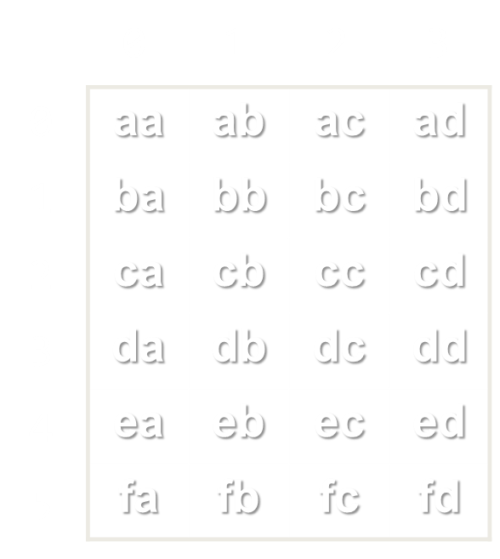
Arrays and Matrices
Live Demo

Slide 18
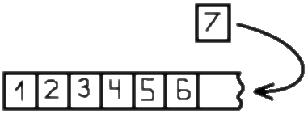
Lists of Elements
Working with List<T>

Slide 19
Lists
In C# arrays have fixed length
Cannot add / remove / insert elements
Lists are like resizable arrays
Allow add / remove / insert of elements
Lists in C# are defined through the List<T> class
Where T is the type of the list, e.g. string or int
List<int> numbers = new List<int>();
numbers.Add(5);
Console.WriteLine(numbers[0]); // 5

Slide 20
List<T> – Example
List<string> names =
new List<string>() { "Peter", "Maria", "Katya", "Todor" };
names.Add("Nakov"); // Peter, Maria, Katya, Todor, Nakov
names.RemoveAt(0); // Maria, Katya, Todor, Nakov
names.Insert(3, "Sylvia"); // Maria, Katya, Todor, Sylvia, Nakov
names[1] = "Michael"; // Maria, Michael, Todor, Sylvia, Nakov
foreach (var name in names)
{
Console.WriteLine(name);
}

Slide 21


List<T>
Live Demo

Slide 22
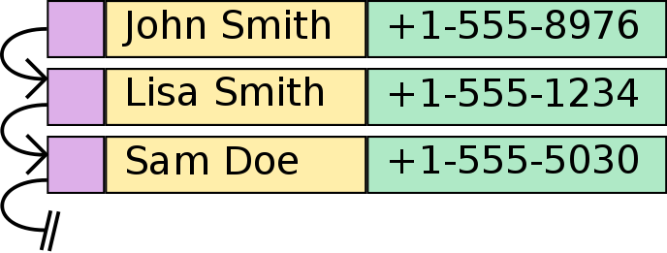
Associative Arrays
Dictionary<Key, Value>

Slide 23
Associative Arrays (Maps, Dictionaries)
Associative arrays are arrays indexed by keys
Not by the numbers 0, 1, 2, …
Hold a set of pairs <key, value>
Traditional array
Associative array
key
value
key
0 1 2 3 4
John Smith | +1-555-8976
Lisa Smith | +1-555-1234
Sam Doe | +1-555-5030
value
8 | -3 | 12 | 408 | 33

Slide 24
Phonebook – Example
Dictionary<string, string> phonebook =
new Dictionary<string, string>();
phonebook["John Smith"] = "+1-555-8976";
phonebook["Lisa Smith"] = "+1-555-1234";
phonebook["Sam Doe"] = "+1-555-5030";
phonebook["Nakov"] = "+359-899-555-592";
phonebook["Nakov"] = "+359-2-981-9819";
phonebook.Remove("John Smith");
foreach (var pair in phonebook)
{
Console.WriteLine("{0} --> {1}", entry.Key, entry.Value);
}

Slide 25
Events – Example
Dictionary<DateTime, string> events =
new Dictionary<DateTime, string>();
events[new DateTime(1998, 9, 4)] = "Google's birth date";
events[new DateTime(2013, 11, 5)] = "SoftUni's birth date";
events[new DateTime(1975, 4, 4)] = "Microsoft's birth date";
events[new DateTime(2004, 2, 4)] = "Facebook's birth date";
events[new DateTime(2013, 11, 5)] =
"Nakov left Telerik Academy to establish SoftUni";
foreach (var entry in events)
{
Console.WriteLine("{0:dd-MMM-yyyy}: {1}",
entry.Key, entry.Value);
}

Slide 26
Associative Arrays
Live Demo

Slide 27
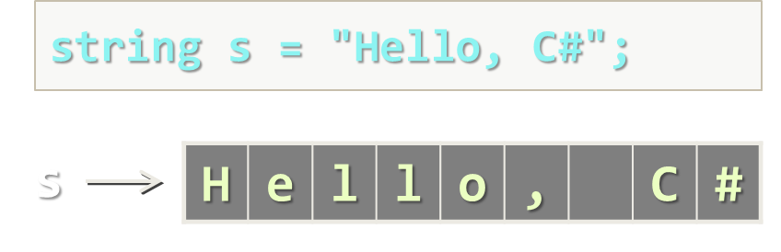
Strings
Basic String Operations

Slide 28
What Is String?
Strings are indexed sequences of Unicode characters
Represented by the string data type in C#
Also known as System.String
Example:
string s = "Hello, SoftUni!";
s
H | e | l | l | o | , |  | S | o | f | t | U | n | i | !
0 1 2 3 4 5 6 7 8 9 10 11 12 13 14

Slide 29
Working with Strings in C#
Strings in C#
Knows its number of characters – Length
Can be accessed by index (0 … Length-1)
Strings are stored in the dynamic memory (managed heap)
Can have null value (missing value)
Strings cannot be modified (immutable)
Most string operations return a new string instance
StringBuilder class is used to build stings

Slide 30
Strings – Examples
string str = "SoftUni";
Console.WriteLine(str);
for (int i = 0; i < str.Length; i++)
{
Console.WriteLine("str[{0}] = {1}", i, str[i]);
}
Console.WriteLine(str.IndexOf("Uni")); // 4
Console.WriteLine(str.IndexOf("uni")); // -1 (not found)
Console.WriteLine(str.Substring(4, 3)); // Uni
Console.WriteLine(str.Replace("Soft", "Hard")); // HardUni
Console.WriteLine(str.ToLower()); // softuni
Console.WriteLine(str.ToUpper()); // SOFTUNI

Slide 31
Strings – Examples (2)
string firstName = "Steve";
string lastName = "Jobs";
int age = 56;
Console.WriteLine(firstName + " " + lastName +
" (age: " + age + ")"); // Steve Jobs (age: 56)
string allLangs = "C#, Java; HTML, CSS; PHP, SQL";
string[] langs = allLangs.Split(new char[] {',', ';', ' '},
StringSplitOptions.RemoveEmptyEntries);
foreach (var lang in langs)
Console.WriteLine(lang);
Console.WriteLine("Langs = " + string.Join(", ", langs));
Console.WriteLine(" \n\n Software University ".Trim());

Slide 32
Strings
Live Demo

Slide 33
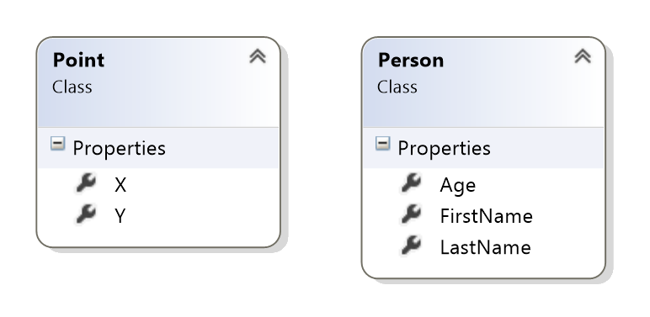
Defining Simple Classes
Using Classes to Hold a Set of Fields

Slide 34
Classes in C#
Classes in C# combine a set of named fields / properties
Defining a class Point holding X and Y coordinates:
Creating class instances (objects):
class Point
{
public int X { get; set; }
public int Y { get; set; }
}
Point start = new Point() { X = 3, Y = 4 };
Point end = new Point() { X = -1, Y = 5 };

Slide 35
Arrays of Objects
We can create arrays and lists of objects:
Point[] line = new Point[]
{
new Point() { X = -2, Y = 1 },
new Point() { X = 1, Y = 3 },
new Point() { X = 4, Y = 2 },
new Point() { X = 3, Y = -2 },
};
for (int i = 0; i < line.Length; i++)
{
Console.WriteLine("Point(" + line[i].X + ", " + line[i].Y + ")");
}

Slide 36
Defining and Using Classes – Example
class Person
{
public string FirstName { get; set; }
public string LastName { get; set; }
public int Age { get; set; }
}
…
Person[] people = new Person[]
{
new Person() { FirstName = "Larry", LastName = "Page", Age = 40},
new Person() { FirstName = "Steve", LastName = "Jobs", Age = 56},
new Person() { FirstName = "Bill", LastName = "Gates", Age = 58},
};

Slide 37
Defining and Using Classes – Example (2)
Console.WriteLine("Young people: ");
foreach (var p in people)
{
if (p.Age < 50)
{
Console.WriteLine("{0} (age: {1})", p.LastName, p.Age);
}
}
var youngPeople = people.Where(p => p.Age < 50);
foreach (var p in youngPeople)
{
Console.WriteLine("{0} (age: {1})", p.LastName, p.Age);
}

Slide 38
Defining and Using Simple Classes
Live Demo

Slide 39

Summary
Methods are reusable named code blocks
.NET Framework provides a rich class library
Arrays are indexed blocks of elements (fixed-length)
Lists are indexed sequences of elements (variable-length)
Dictionaries map keys to values and provide fast access by key
Strings are indexed sequences of characters
Classes combine a set of fields into a single structure
Objects are instances of classes

Slide 40









C# Advanced Topics
https://softuni.bg/courses/programming-basics/

Slide 41
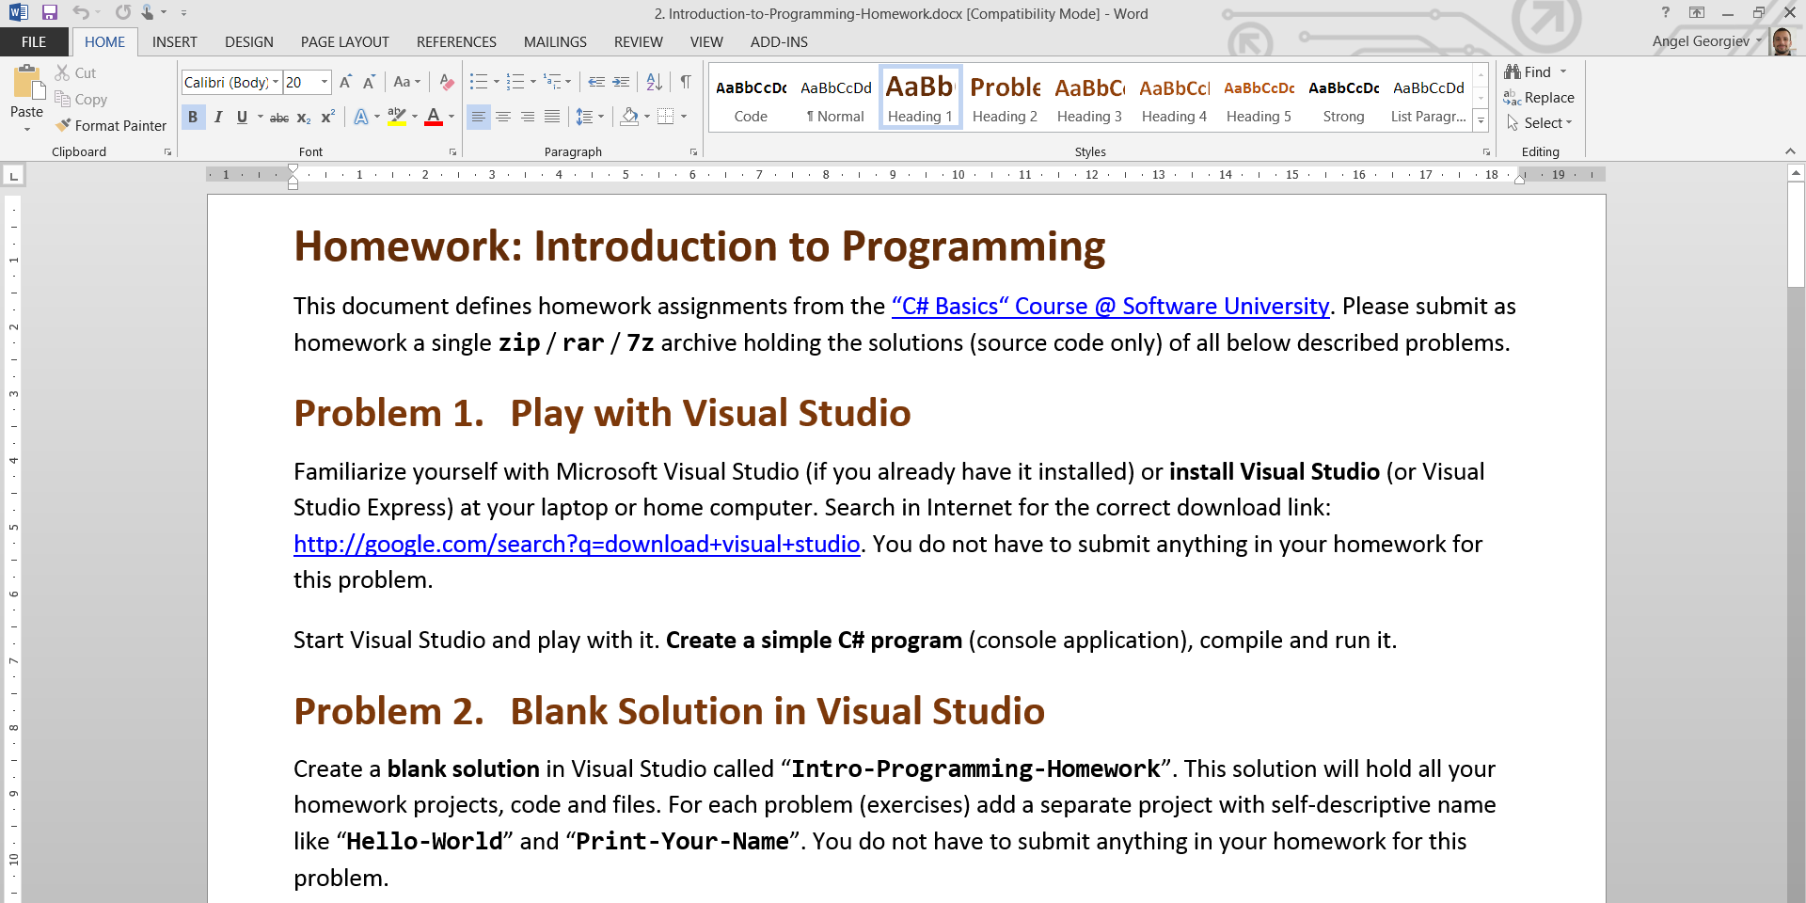
Homework Review
Live Demo

Slide 42
License
This course (slides, examples, demos, videos, homework, etc.) is licensed under the "Creative Commons Attribution-NonCommercial-ShareAlike 4.0 International" license
Attribution: this work may contain portions from
"Fundamentals of Computer Programming with C#" book by Svetlin Nakov & Co. under CC-BY-SA license

Slide 43





Free Trainings @ Software University
Software University Foundation – softuni.org
Software University – High-Quality Education, Profession and Job for Software Developers
softuni.bg
Software University @ Facebook
facebook.com/SoftwareUniversity
Software University @ YouTube
youtube.com/SoftwareUniversity
Software University Forums – forum.softuni.bg

